Slide 1







PROJECTS | PRODUCTS | COURSE | INTERNSHIP
info@discoverprojects.com
www.discoverprojects.com
pro.aiskool@gmail.com
www.aiskool.com
Shop no. 2, Narayan Smurti Building, Opp. Saraswati Book Depot,
Near CIDCO Bus Stop, Thane West, India.
+91 9967478289 / +91 9167769993

Slide 2


BIKE SHARING
Relevant Image

Slide 3
Introduction and Application
The objective is to build a prediction engine for analysis of bike sharing data using Neural Network.

Slide 4
Working
FIRST STEP WAS TO COLLECT DATA FROM DIFFERENT SOURCES FOR OUR PROBLEM STATEMENT .
THEN WE HAVE TO CLEAN , PROCESS CATEGORICAL DATA AND NORMALISE IT.
THEN WE SHOW VARIOUS ANALYSIS USING GRAPHS.
SPLIT THE DATA INTO TRAINING AND TEST SET.
SELECT AN ALGORITHM.
FITTING THE MODEL TO TRAINING SET.
CHECK ACCURACY OF TRAINED DATA W.R.T TRAIN SET.
TEST THE TRAINED MODEL W.R.T TESTING SET.
CHECK ACCURACY OF TEST DATA W.R.T TEST SET.
BASED ON THE GENERATED GRAPHS WE CAN ANALYSE THE DATA.

Slide 5
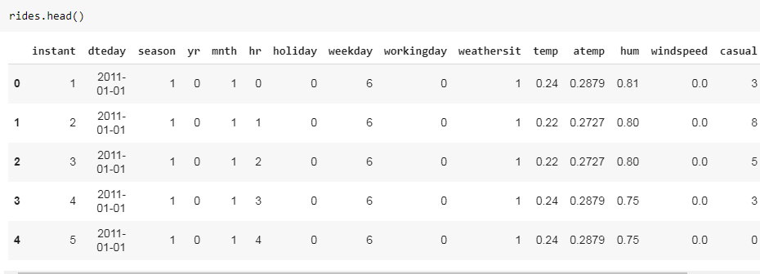
Working and Building
This is the data that we are using for the analysis of bike sharing. The source of dataset is Kaggle.

Slide 6
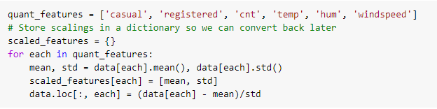
Handling Categorical Data
loc gets rows (or columns) with particular labels from the index and helps in handling of categorical data.

Slide 7
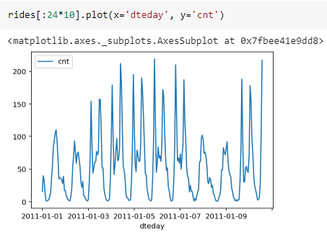
Graphs
Here we have used the plot function of matplotlib library to create a graph between x and y.

Slide 8
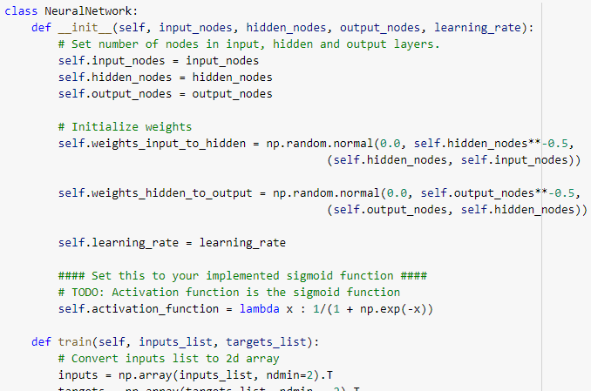
Selecting Algorithm
A neural network is a series of algorithms that endeavors to recognize underlying relationships in a set of data through a process that mimics the way the human brain operates. Here we have simply created a class for neural network with its elements being nodes.

Slide 9
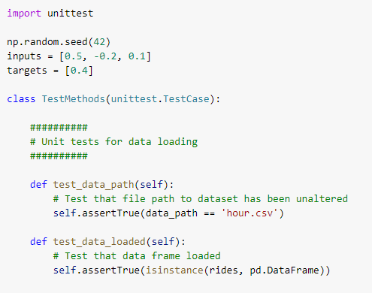
Prediction
We have created few functions for the predictions on test data.

Slide 10
Evaluate, Tune and Improve Neural Network
In this code we have used the MSE method for evaluation.
Mean Square Error: MSE is calculated by taking the average of the square of the difference between the original and predicted values of the data.

Slide 11

Calculating Efficiency:

Slide 12
FAQ
What is the use of read_csv()?
read_csv() is an important pandas function to read csv files and do operations on it.
2. How to choose the number of hidden layers and nodes in a feedforward neural network?
The number of hidden neurons should be between the size of the input layer and the size of the output layer.
The number of hidden neurons should be 2/3 the size of the input layer, plus the size of the output layer.
The number of hidden neurons should be less than twice the size of the input layer.

